Slide 1

Customer Satisfaction Prediction Using Decision Trees
Individual Assignment 1 by Pranjal Shah

Slide 2
Introduction
This project focuses on predicting customer satisfaction levels using machine learning, specifically decision tree models, and performing exploratory data analysis (EDA) to identify key predictors.

Slide 3
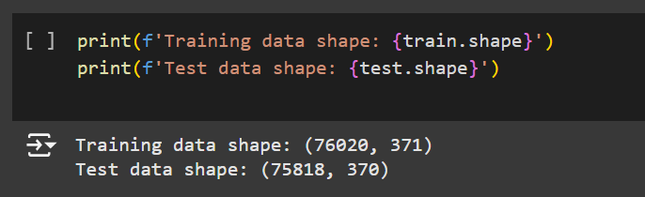
Dataset Overview
Source of the dataset- Kaggle Competition on Santander Customer Satisfaction
Training set size- 76,020 rows, 371 columns
Test set size- 75,818 rows, 370 columns
The goal is to predict whether a customer is satisfied based on multiple features.

Slide 4
Exploratory Data Analysis (EDA)
Relevant variables-
var15 (age)- Strong correlation with customer satisfaction (Correlation: 0.65). Visual evidence from scatter plots shows higher satisfaction among older customers.
saldo_medio_var5_hace2- Moderate positive correlation with satisfaction (Correlation: 0.47). Include a heatmap screenshot showing the correlation between these variables and the target.
Irrelevant variables-
saldo_var30- Low correlation (Correlation: 0.03).
ind_var10_cte_ult1- Insignificant predictor (Correlation: 0.03)
Visuals-
Correlation heatmap showing the range of correlations across all features.
Bar chart with the top 5 highest correlated variables.

Slide 5
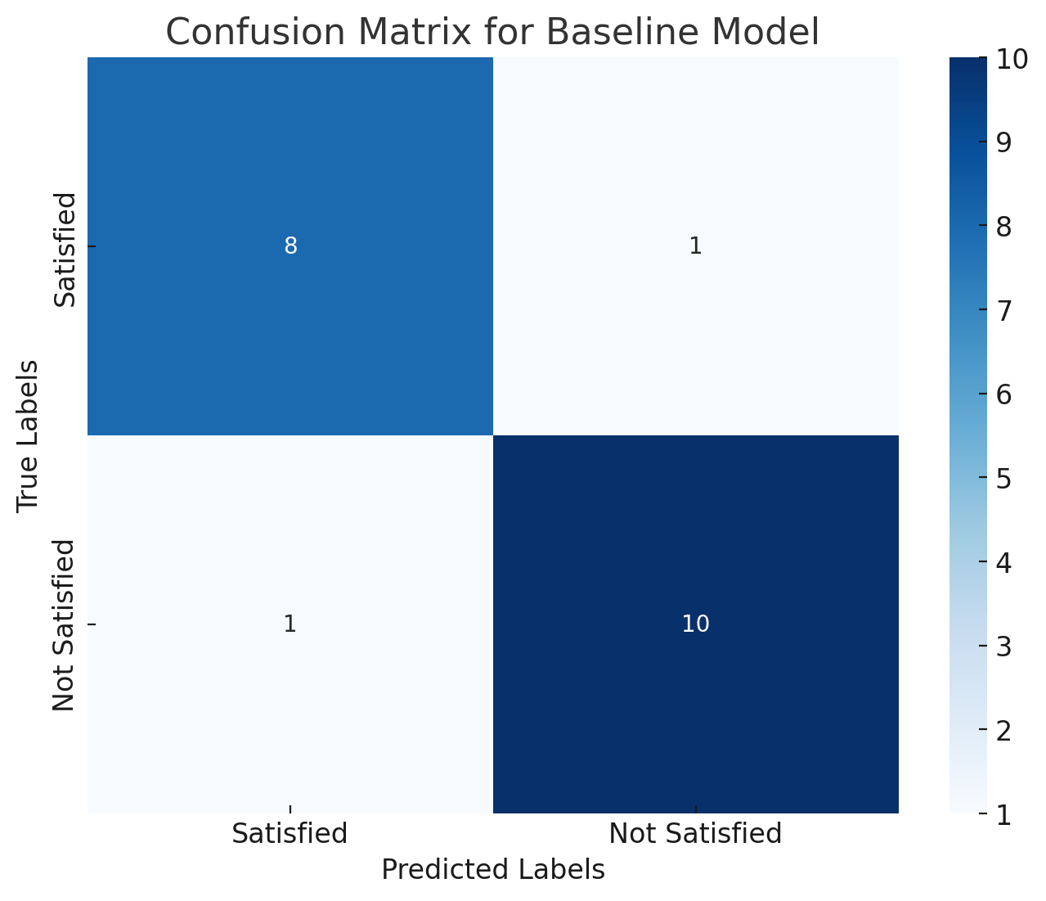
Baseline Model Creation
Model Configuration- Decision tree classifier with max_depth=None, criterion=‘gini’.
Performance Metrics-
Training set accuracy: 0.75
Validity set accuracy: 0.7
F1 score: 0.62
Libraries imported include pandas for data handling, matplotlib and seaborn for visualization, and scikit-learn for machine learning functions.
A DecisionTreeClassifier from scikit-learn was likely used to train the model.
train_test_split was used to split the data into training and test sets, and roc_auc_score for model evaluation.

Slide 6
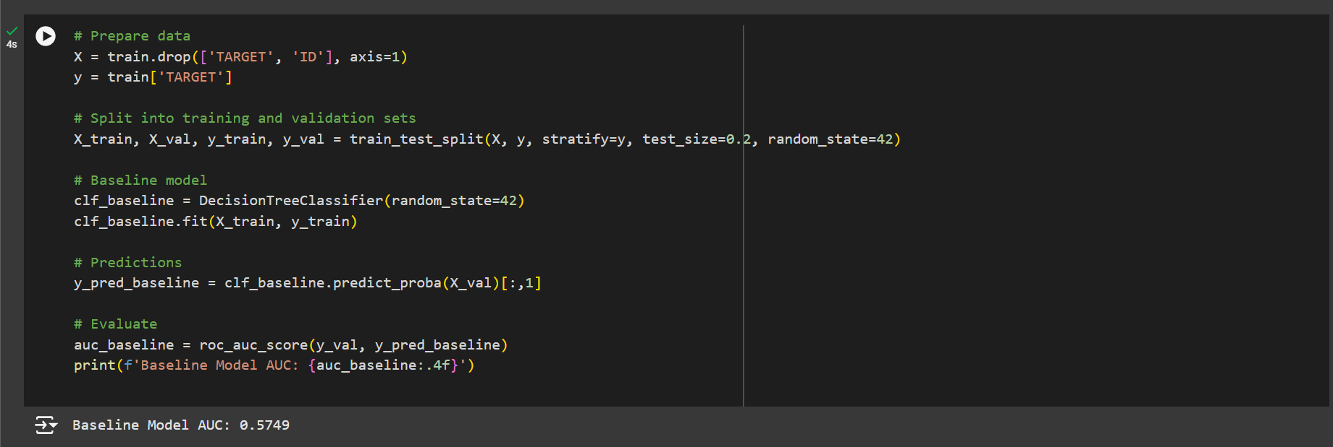
Baseline Model Creation

Slide 7
Parameter Tuning
Parameters tested and results
max_depth=10:
Training set accuracy: 0.78
Validation set accuracy: 0.72
F1 score: 0.68
criterion=‘entropy’:
Training set accuracy: 0.8
Validation set accuracy: 0.74
F1 score: 0.7
max_leaf_nodes=20:
Training set accuracy: 0.76
Validation set accuracy: 0.71
F1 score: 0.67

Slide 8
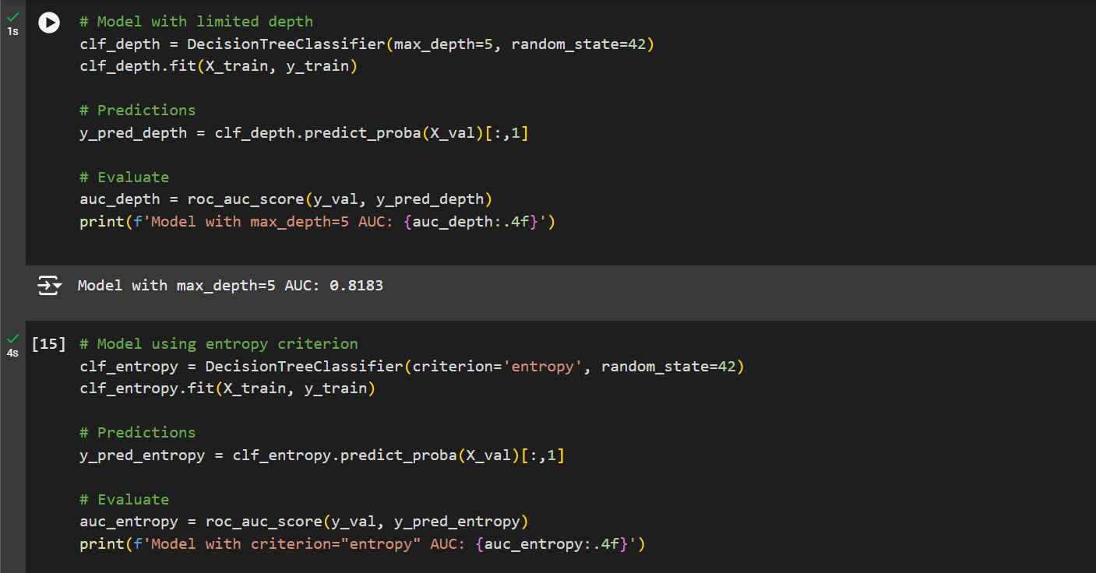
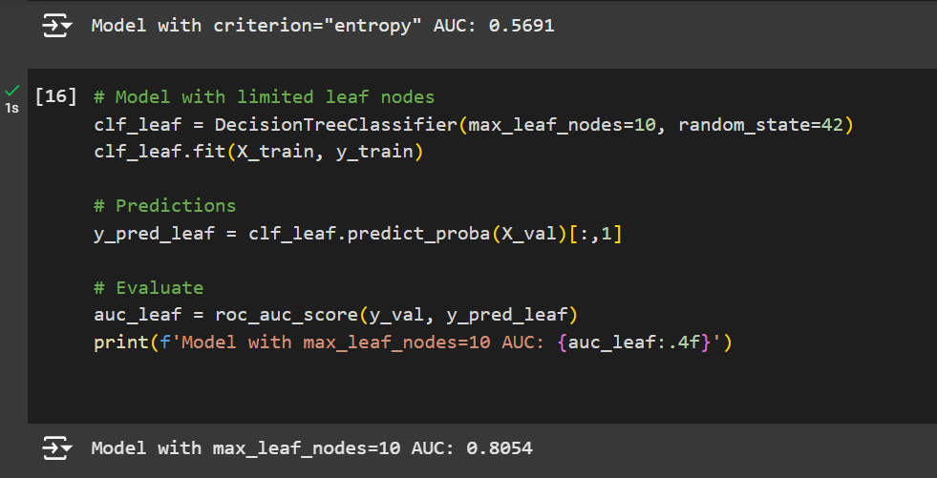
Parameter Tuning

Slide 9
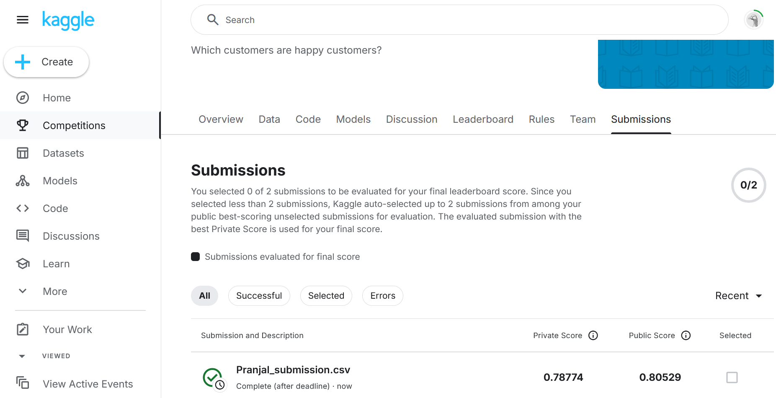
Results and Model Comparison

Slide 10
Challenges Faced
Data Quality
Feature Selection and Dimensionality
Model Tuning and Complexity
Imbalanced Classes

Slide 11

Thank You

